Slide 1

LAB 4: Single-child Layouts
Duhok Polytechnic University
Technical College of Zakho
Department of CIS
Mobile application

Slide 2
Objectives
Understand layouts
Learn the difference between child and children
Alignment
Adding spaces
Defining sizes
Containing widgets

Slide 3
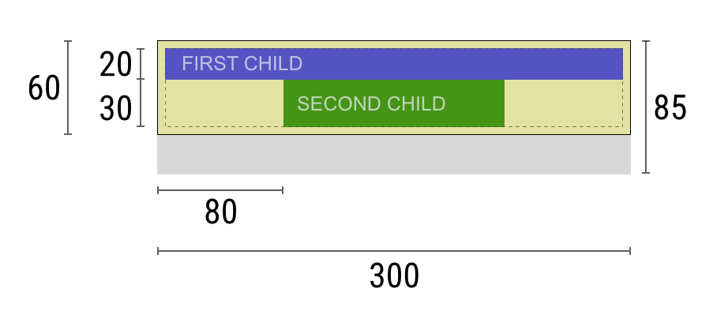
What is a Layout?
In mobile development, a Layout is the process of defining the visual structure for a user interface. It determines the size and position of widgets on the screen.
The Container Logic: Layouts act as invisible containers that hold other widgets.
The Rules of Space: A layout tells a widget:
“You are 50 pixels wide”.
“You are centered vertically”.
“You must sit exactly below this other button.”

Slide 4
Child vs Children
The Two Main Types of Layouts
Single-Child Layouts: Focus on positioning or sizing a single element.
Examples: Center/Align(alignment), Padding(spacing), SizedBox(dimensions), Container(jack of all trades).
Multi-Child Layouts: * Focus on how a group of elements relate to each other.
Examples: Row (side-by-side), Column (top-to-bottom), Stack (on top of each other)

Slide 5
Align
While Center always puts the child in the middle, the Align widget gives you total control. It allows you to place a child at any of the nine standard positions (corners, edges, or center) within the parent’s boundaries.
Key attributes:
child: The widget to be positioned.
alignment: Uses the Alignment class to set the position:
Alignment.topRight, Alignment.bottomLeft, Alignment.centerLeft, etc.
Alignment(0.5, -0.5): Custom coordinates where (0,0) is the center.

Slide 6
Padding
In Flutter, "everything is a widget," including empty space. The Padding widget is used to create a buffer or "breathing room" around its child. Instead of the child touching the boundaries of its parent, Padding pushes the child inward by a specified amount.
Key attributes:
child: The widget that will be wrapped by the empty space.
padding: Defines the amount of space. It requires an EdgeInsets object:
EdgeInsets.all(16.0): Same space on all 4 sides.
EdgeInsets.symmetric(vertical: 10, horizontal: 20): Different space for top/bottom vs. sides.
EdgeInsets.only(left: 50): Space on one specific side only.
EdgeInsets.directional(start:50): Similar to EdgeInsets.only(left: 50), but is dependent on the language of the application.
EdgeInsets.zero: Removes spacing from all 4 sides.

Slide 7
SizedBox
The SizedBox is a simple box with a specified size. It is used for two main purposes: forcing a child to have specific dimensions, or acting as an "empty gap" between two widgets to create space without using padding.
Key attributes:
child: The widget you want to resize. (Note: If no child is provided, it simply occupies empty space).
width: Forces the child to be a specific number of pixels wide.
height: Forces the child to be a specific number of pixels tall.
Alternative:
SizedBox.shrink(): A named constructor that creates a box with zero width and height—useful for "hiding" widgets.

Slide 8
Container
The Container is the "Swiss Army Knife" of Flutter. It is a single-child widget that combines the abilities of Padding, Align, SizedBox, and more. Use a Container when you need to style the background (color, borders, shadows) or apply complex constraints to a single element.
Key attributes:
child: The widget you want to contain.
width / height: Sets fixed dimensions for the box.
alignment: Aligns the child within the container.
margin: Space outside the container’s border.
padding: Space inside the container’s border.
decoration: Uses BoxDecoration to set color, borderRadius, border, and boxShadow.

Slide 9
Container (cont.)
The BoxDecoration class provides a variety of ways to draw a box. It is the most common way to style a Container. It allows you to define how the container's background is painted (color, gradient, or image), how the edges are shaped (borders and rounded corners), and how it casts shadows.
Technical Rule: If you use a decoration in a Container, you must move the color property from the Container itself into the BoxDecoration. Having a color in both will cause an error.
Key attributes:
color: Sets the background color of the box (e.g., Colors.blue).
borderRadius: Defines the "roundness" of the corners using BorderRadius.circular().
border: Adds a stroke around the box. You can define the color and width using Border.all().
boxShadow: Accepts a List of BoxShadow objects to create depth and elevation effects.
gradient: Allows you to transition between multiple colors (e.g., LinearGradient).
shape: Can change the box from a rectangle to a BoxShape.circle.

Slide 10
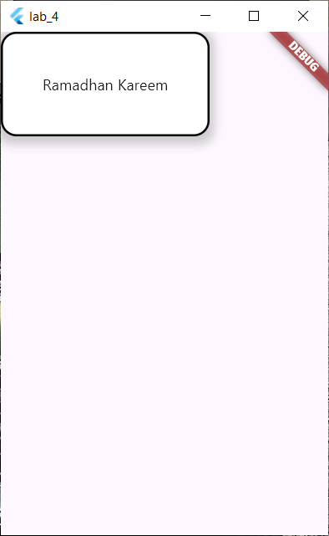
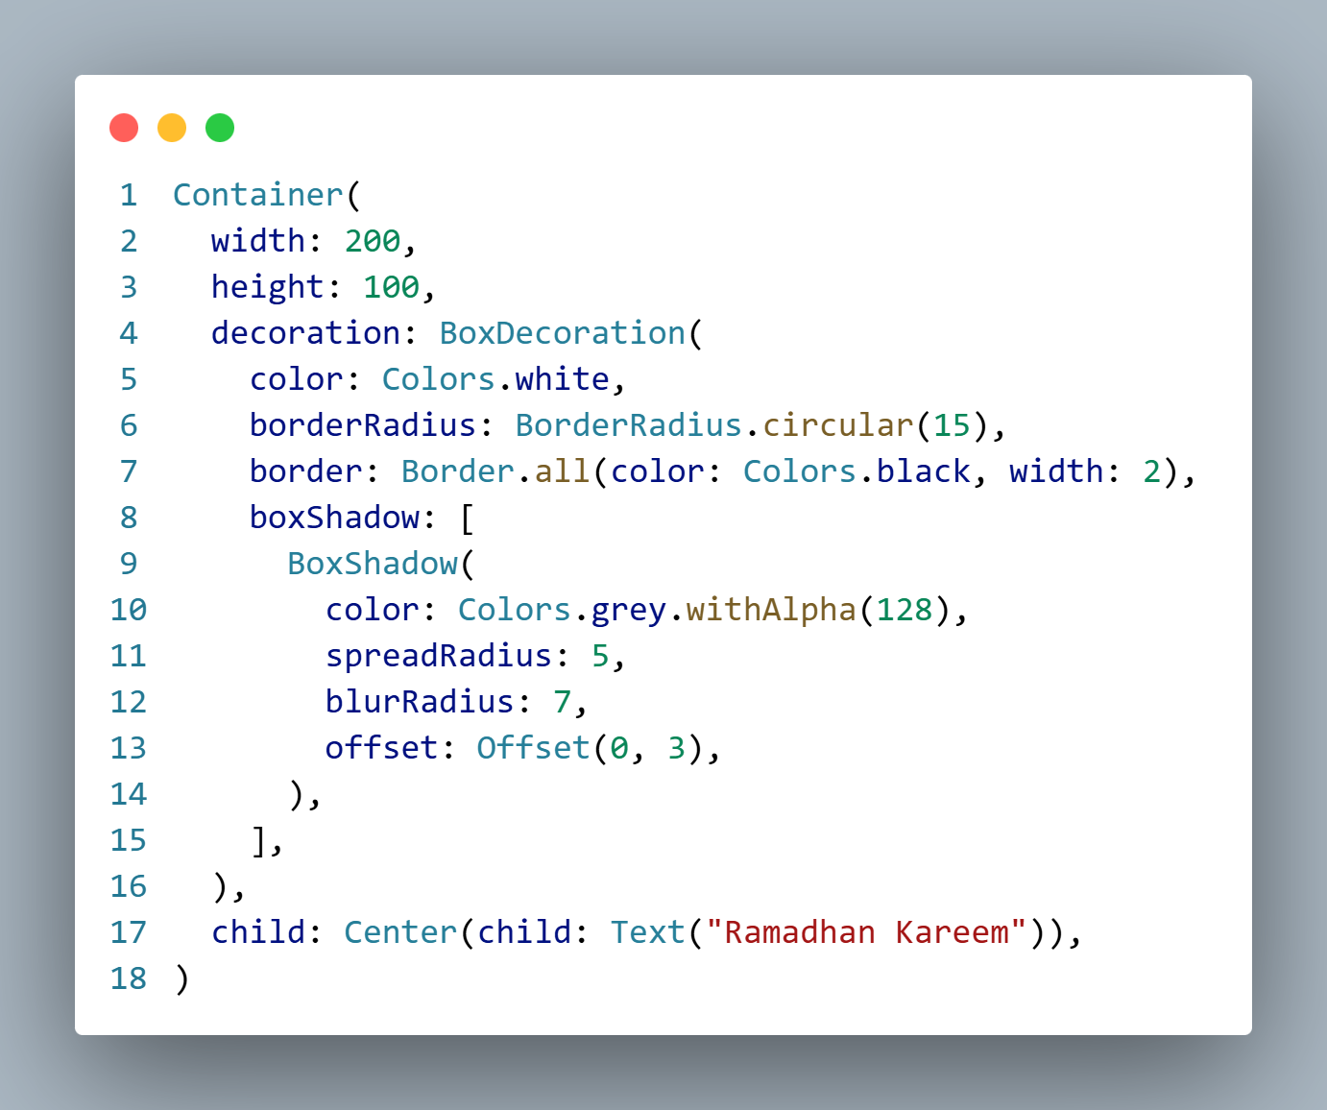
Example

Slide 11
Any Questions?
?

