Slide 1

LAB 3:
Diving Into Flutter
Duhok Polytechnic University
Technical College of Zakho
Department of CIS
Mobile application

Slide 2
Objectives
Understand the Flutter Ecosystem
Core Pillars
Recognize Widgets
Create Your First App
Use MaterialApp, Scaffold, Center, and Text widgets

Slide 3

What is Flutter?
Not just a Library: It’s a complete UI Software Development Kit (SDK) created by Google.
Single Codebase: Write once in Dart and deploy natively to:
  Mobile (Android & iOS)
  Web
  Desktop (Windows, macOS, Linux)
Pixel Perfect: Unlike other frameworks, Flutter doesn't use the phone's native UI components (buttons, toggles). It paints every pixel itself using a high-performance engine.

Slide 4
The Core Pillars
The Framework (Dart): The part we interact with. It contains the "Material" (Android style) and "Cupertino" (iOS style) widget libraries.
The Engine (C/C++): The powerhouse that handles graphics, text layout, and file I/O. It uses Impeller (or Skia) to draw the UI at 60–120 FPS.
The Embedder: The "glue" that allows Flutter to run on specific operating systems like Android or iOS.

Slide 5
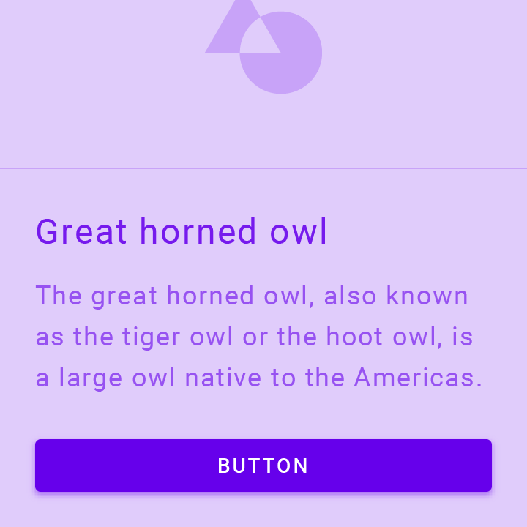
Everything is a Widget
In Flutter, the Widget is the basic unit of composition.
It’s not just a UI element: A widget can represent:
  Structural elements (a button or menu)
  Styling elements (a font or color theme)
  Layout aspects (padding, alignment, or centering)
  Functional logic (navigation or state)
Widget

Slide 6
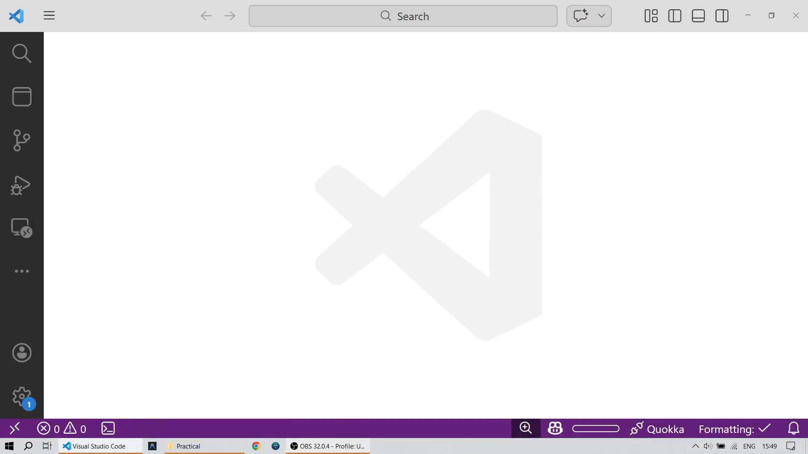
Create Your First Application
Open VS Code.
Press [Ctrl + Shift + P].
Type “Flutter: New Project”.
Select “Empty Application”.
Pick your project directory.
Type the name you want for your project. P.S. Project names must be snake_case compliant (e.g. “lab_3”).
Press [Enter].
  P.S. Press [F5] to run the app.

Slide 7
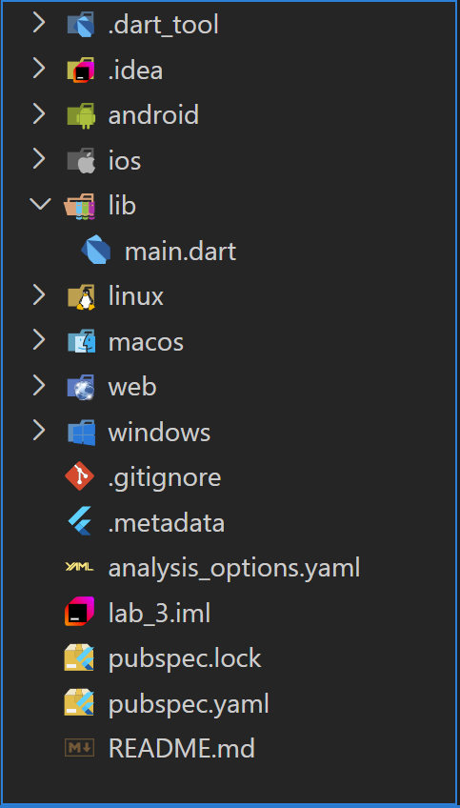
Project Structure
When you create a project, Flutter generates several folders. Here are the ones that matter:
lib/: The most important folder. It contains the main.dart file which is the starting point of your application. This is where all your Dart code lives. 99% of your development happens here.
pubspec.yaml: The project’s "Configuration Manual." Use this to add external packages (plugins), assets (images/videos), and custom fonts.
android/, ios/, linux/, web/ & windows/: Contain platform-specific code.
  Rule of Thumb: Do not modify these unless you are adding specific permissions (like Camera or GPS access).
build/: Stores the output files when you run or compile your app. You can safely ignore or delete this; Flutter will recreate it.

Slide 8
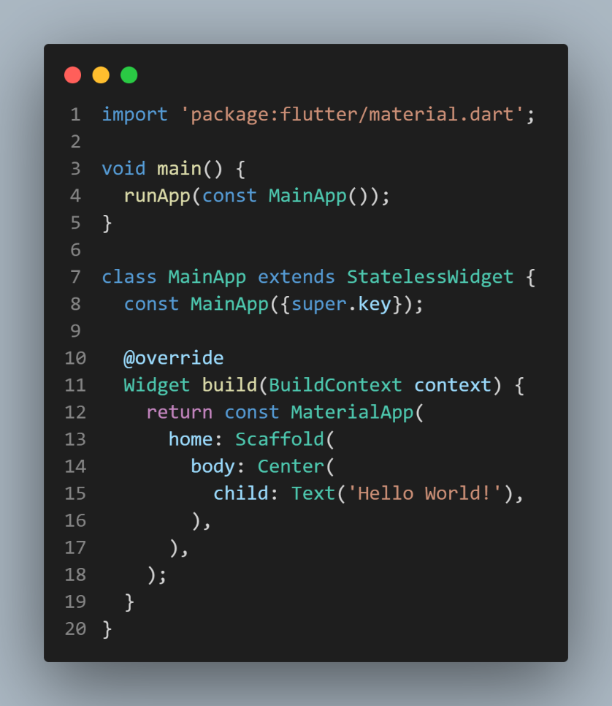
The Widget Tree
The Widget Tree is a declarative configuration. Each constructor in your MainApp code defines a node in this tree.
MaterialApp (The Root): Sets up the WidgetsApp at the base of the tree. It initializes the Navigator and ThemeData, providing the foundational context for the entire application.
Scaffold (Structural Layout): Implements the basic visual layout structure. It occupies the full screen and provides slots (slots are technically GlobalKey regions) for the appBar, body, and drawer.
Center (Layout Constraint): A positioning widget that applies an Alignment constraint to its child. It tells the framework to place the child at the midpoint of the available space provided by the Scaffold.
Text (The Leaf): A "Leaf Node" (a widget with no children). It passes string data and styling to a RenderParagraph object which eventually handles the glyph painting.

Slide 9
MaterialApp
The MaterialApp is a convenience widget that wraps a number of widgets that are commonly required for applications implementing Material Design. It acts as the "Engine Room" for your app's global settings and navigation.
Key attributes:
  home: Defines the default route of the app (the first screen the user sees). This is typically a Scaffold widget.
  title: A one-line description of the app used by the device's operating system (e.g., in the task switcher).
  theme: Sets the global visual identity (colors, fonts, button styles) using the ThemeData class.
  debugShowCheckedModeBanner: A boolean (default true) that displays a "DEBUG" banner in the corner. Setting this to false removes it for a cleaner look.
  routes: A map (dictionary) that defines the named navigation paths for multi-screen applications.

Slide 10
Scaffold
The Scaffold is the structural framework of an individual screen. It provides a consistent visual structure by offering specific "slots" for standard Material Design components.
Key Attributes:
  appBar: A horizontal bar typically displayed at the top of the app (using the AppBar widget).
  body: The primary content area of the scaffold. This is where your main UI (Lists, Columns, etc.) resides.
  floatingActionButton (FAB): A circular icon button that hovers over the content, usually for a primary action like "Add" or "Compose."
  drawer: A panel that slides in horizontally from the edge of the Scaffold to show navigation links.
  bottomNavigationBar: A bar at the bottom of the screen for primary destinations in an app.
  backgroundColor: Sets the color of the entire surface behind the body.

Slide 11
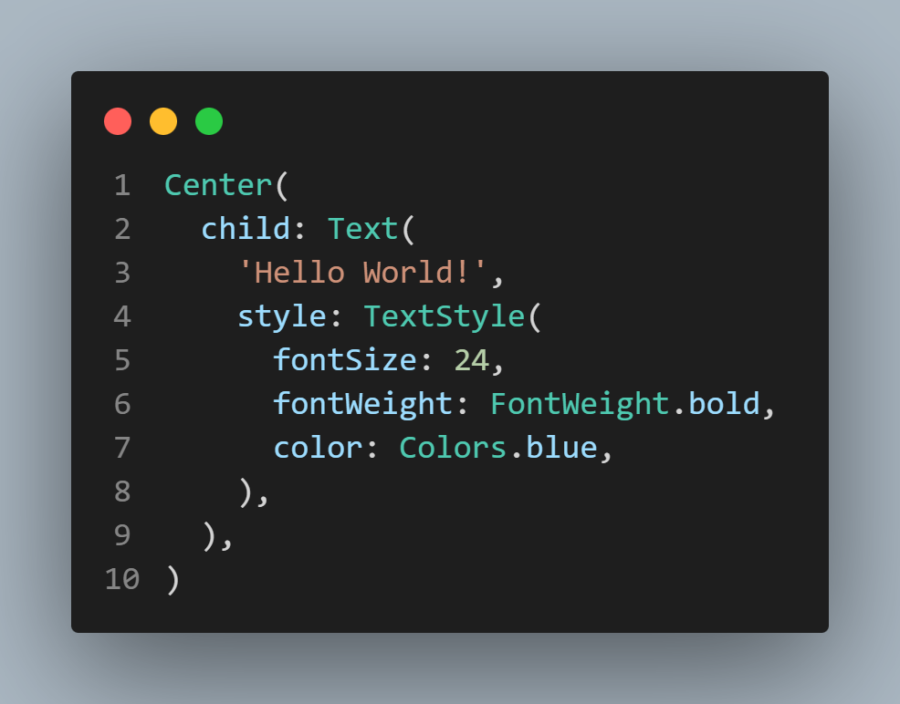
Center & Text
The Center widget is a layout tool that does exactly what its name suggests—it centers its child within itself.
Key attribute:
  child: Accepts a single widget to be centered.
The Text widget is the most fundamental "leaf" widget used to display a string of text with a single style.
Key Attributes:
  data (String): The actual text to display (e.g., 'Hello World').
  style: Uses the TextStyle class to define color, font size, weight, and letter spacing.
  textAlign: Aligns the text horizontally (Left, Right, Center, or Justify).
  overflow: Handles text that is too long for its container (e.g., TextOverflow.ellipsis adds "...").

Slide 12
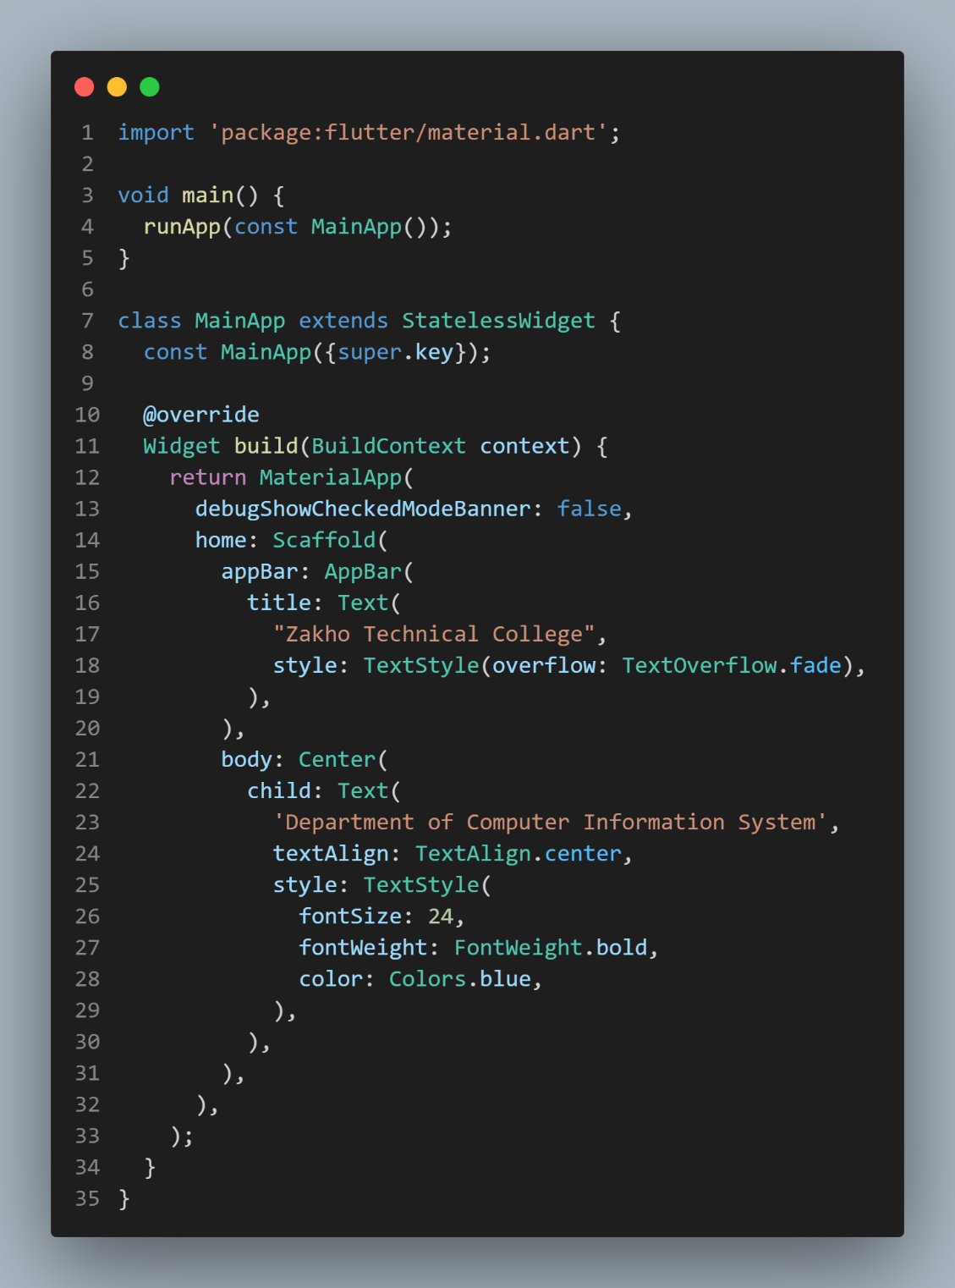
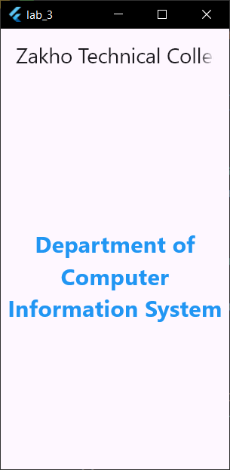
Example

Slide 13
Any Questions?
?

Slide 14
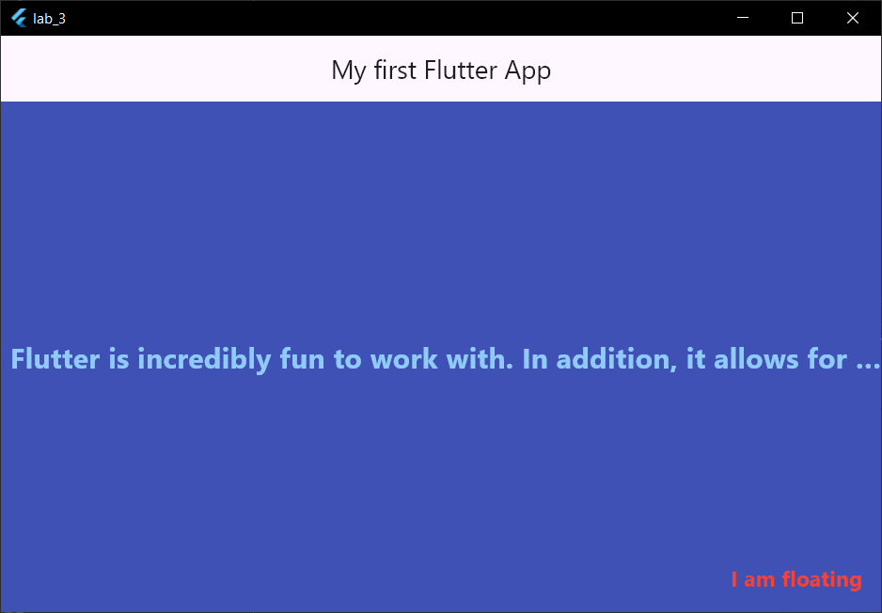
Lab Work
Notes:
// Solution
import 'package:flutter/material.dart';
void main() {
runApp(const MainApp());
}
class MainApp extends StatelessWidget {
const MainApp({super.key});
@override
Widget build(BuildContext context) {
return MaterialApp(
debugShowCheckedModeBanner: false,
home: Scaffold(
backgroundColor: Colors.indigo,
floatingActionButton: Text(
"I am floating",
style: TextStyle(
fontSize: 18,
fontWeight: FontWeight.bold,
color: Colors.red,
),
),
appBar: AppBar(centerTitle: true, title: Text("My first Flutter App")),
body: Center(
child: Text(
'Flutter is incredibly fun to work with. In addition, it allows for rapid development and a great developer experience.',
textAlign: TextAlign.right,
overflow: TextOverflow.ellipsis,
style: TextStyle(
fontSize: 24,
fontWeight: FontWeight.bold,
color: Colors.blue[200],
),
),
),
),
);
}
}

