Slide 1

Kurdistan Regional Government-Iraq
Ministry of Higher Education and Scientific Research
Duhok Polytechnic University
Technical Collage of Zakho
Dept. of CIS
Queue Algorithm
Lecturers: Sipan M. Hameed & Ahmed Jamil

Slide 2
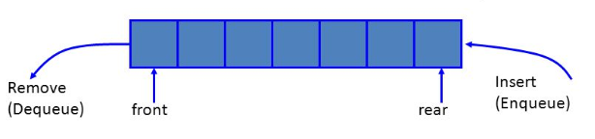
Queue ADT
A Queue is a data structure that has two ends:
  Elements are added at one end called “rear”.
  And removed from the other end called “front”.
Insertions and deletions follow First-in First-out (FIFO) scheme (principle).
  It means that the element added first will be removed first.

Slide 3
Queue ADT
Main operations
  enqueue(object): Insert element at rear.
  object dequeue(): Remove and returns element at front.
Others operations
  object front(): returns front element without removing it.
  integer size(): returns number of elements stored.
  boolean isEmpty(): returns whether no elements are stored.

Slide 4
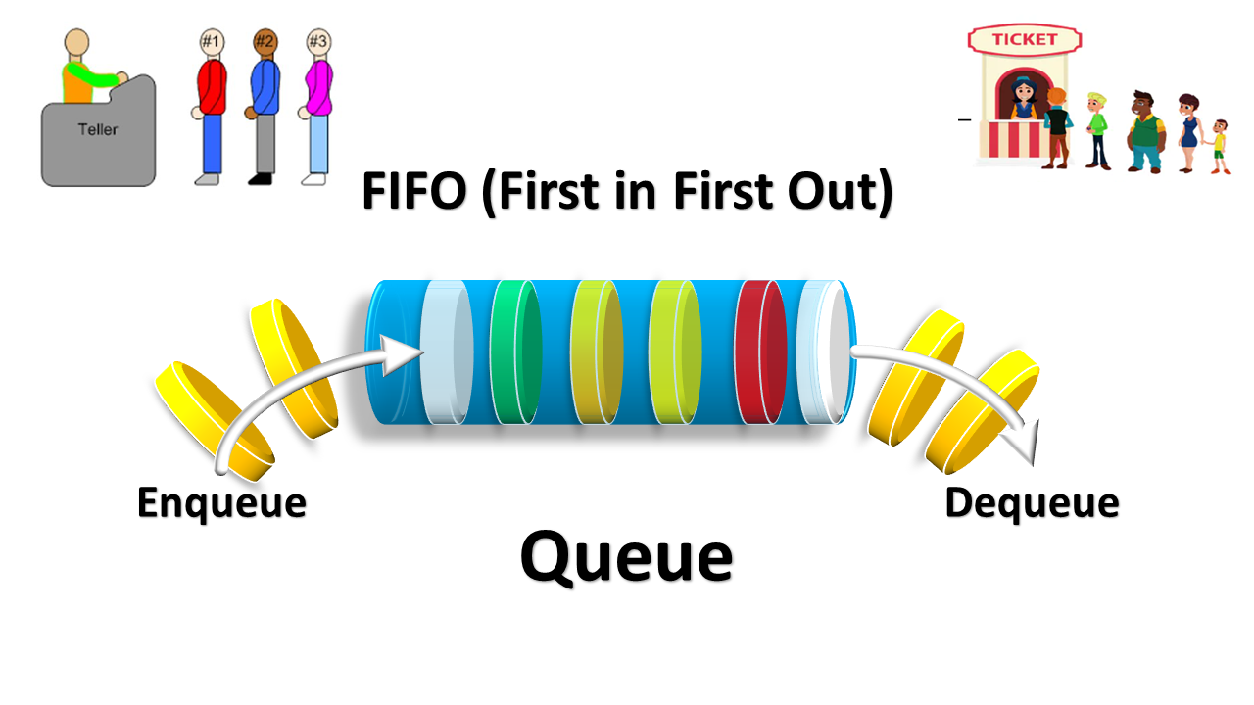
Applications of Queues
  Waiting lines.
  Access to shared resources.
  Hold jobs for a printer.
  The most common application is in client-server models
  Multiple clients may be requesting services from one or more servers
  Some clients may have to wait while the servers are busy
  Those clients are placed in a queue and serviced in the order of arrival
Notes:
Multiprogramming – a way of achieving a limited form of parallelism, even on a computer that has only one CPU.
Can be done by using a queue to keep track of whose turn it is to use system resources in a round robin protocol

Slide 5
Array-based Queue
Add elements in an array Q of capacity(size) N.
Two Variables:
  front that points to the beginning of the Queue.
  rear that points to the end of the Queue.
Notes:
.
Each of these run in O(1)
Actual application may need less or more memory!

Slide 6
Enqueue and Dequeue Algorithms
Algorithm Enqueue(Element):
if isFull then
throw Full Queue Exception
else
Q[rear] ← element
rear ← rear + 1
Algorithm Dequeue():
if isEmpty then
throw Empty Queue Exception
else
item ← Q[front]
Q[front] ← Null
front ← front+1
return item

Slide 7
Queue Operations - Example
6
Enqueue (9)
{
if rear==N-1 Then
“Overflow”
else
Q[rear]=9
rear=rear+1
}
6
5
5
4
4
3
3
2
2
1
rear
1
0
Front, rear
9
0
front
Queue Q, N=7
Queue Q, N=7

Slide 8
Queue Operations - Example
Queue Q, N=10
0
1
2
3
4
5
6
7
8
9
Enqueue (9)
{
if isFull Then
“Queue is Full”
else
Q[rear]=9
rear=rear+1
}
front
rear
0
1
2
3
4
5
6
7
8
9
9
front
rear

Slide 9
Queue Operations - Example
Queue Q, N=10
0
1
2
3
4
5
6
7
8
9
Enqueue (3)
{
if isFull Then
“Queue is Full”
else
Q[rear]=3
rear=rear+1
}
9
front
rear
0
1
2
3
4
5
6
7
8
9
9
3
front
rear

Slide 10
Queue Operations - Example
Queue Q, N=10
0
1
2
3
4
5
6
7
8
9
Enqueue (5)
{
if isFull Then
“Queue is Full”
else
Q[rear]=5
rear=rear+1
}
9
3
front
rear
0
1
2
3
4
5
6
7
8
9
9
3
5
front
rear

Slide 11
Queue Operations - Example
0
1
2
3
4
5
6
7
8
9
Queue Q, N=10
9
3
5
Dequeue ()
{
if isFull Then
“Queue is empty”
else
item=Q[front]
Q[front]=null
front=front+1
return item
}
front
rear
0
1
2
3
4
5
6
7
8
9
3
5
front
rear

Slide 12
Queue Operations - Example
0
1
2
3
4
5
6
7
8
9
Queue Q, N=10
3
5
Dequeue ()
{
if isEmpty Then
“Queue is empty”
else
item=Q[front]
Q[front]=null
front=front+1
return item
}
front
rear
0
1
2
3
4
5
6
7
8
9
5
front
rear

Slide 13
Queue Operations - Example
Queue Q, N=10
0
1
2
3
4
5
6
7
8
9
5
Dequeue ()
{
if isEmpty Then
“Queue is empty”
else
item=Q[front]
Q[front]=null
front=front+1
return item
}
front
rear
0
1
2
3
4
5
6
7
8
9
front
rear

Slide 14
Queue Operations - Example
Queue Q, N=10
0
1
2
3
4
5
6
7
8
9
Enqueue (8)
Enqueue (1)
Enqueue (12)
Enqueue (11)
Enqueue (4)
Enqueue (6)
Enqueue (13)
front
rear
0
1
2
3
4
5
6
7
8
9
8
1
12
11
4
6
13
front
rear

Slide 15
Queue Operations - Example
Queue Q, N=10
0
1
2
3
4
5
6
7
8
9
8
1
12
11
4
6
13
Now, let’s add one more element 7.
Enqueue (7)
{
if isFull Then
“Queue is Full”
else
Q[rear]=7
rear=rear+1
}
front
rear
What is the problem?
Once queue becomes full, we can not insert the next element even if there is a space in front of queue. waste of memory in a Queue.

Slide 16
Circular Queue
To Solve the waste memory in Queue.

Slide 17
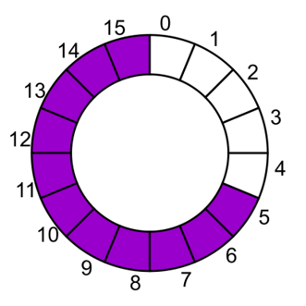

Circular Queue
- Instead of viewing the array on the range 0, …, 15, consider the indices being cyclic:
…, 15, 0, 1, …, 15, 0, 1, …, 15, 0, 1, …
This is referred to as a circular array.
- view Q as a "circular array" that goes from Q [0] to Q [N-1 ] and then immediately back to Q [0] again.
rear
front
rear
front
Notes:
17

Slide 18
Enqueue and Dequeue Algorithms
Algorithm Enqueue(Element):
if isFull then
throw Full Queue Exception
else
Q[rear] ← element
rear ← (rear + 1) mod N
Algorithm Dequeue():
if isEmpty then
throw Empty Queue Exception
else
item ← Q[front]
Q[front] ← Null
front ← (front+1) mod N
return item

Slide 19
CQueue Operations - Example
Queue Q, N=10
0
1
2
3
4
5
6
7
8
9
8
1
12
11
4
6
Enqueue (13)
{
if isFull Then
“Queue is Full”
else
Q[rear]=13
rear=(rear+1) mod N
}
front
rear
0
1
2
3
4
5
6
7
8
9
8
1
12
11
4
6
13
rear
front

Slide 20
CQueue Operations - Example
Queue Q, N=10
0
1
2
3
4
5
6
7
8
9
8
1
12
11
4
6
13
Enqueue (7)
{
if isFull Then
“Queue is Full”
else
Q[rear]=7
rear=(rear+1) mod N
}
rear
front
0
1
2
3
4
5
6
7
8
9
7
8
1
12
11
4
6
13
rear
front

Slide 21
CQueue Operations - Example
0
1
2
3
4
5
6
7
8
9
Queue Q, N=10
8
1
12
11
4
6
13
Dequeue ()
{
if isEmpty Then
“Queue is Empty”
else
item=Q[front]
Q[front]=Null
front=(front+1) mod N
}
rear
front
0
1
2
3
4
5
6
7
8
9
7
1
12
11
4
6
13
rear
front

Slide 22
Exercises
Describe in pseudo-code an algorithm for reversing a queue Q. To access the queue, you are only allowed to use the methods of a queue ADT. Hint: Consider using an auxiliary data structure.

Slide 23
Exercises
A linear list of elements in which deletion can be done from one end (front) and insertion can take place only at the other end (rear) is known as a?
  Queue.
  Stack.
  Tree.
  Linked list.
A queue follows
  FIFO (First In First Out) principle.
  LIFO (Last In First Out) principle.
  Ordered array.
  Linear tree.

Slide 24
Thanks

