Slide 1

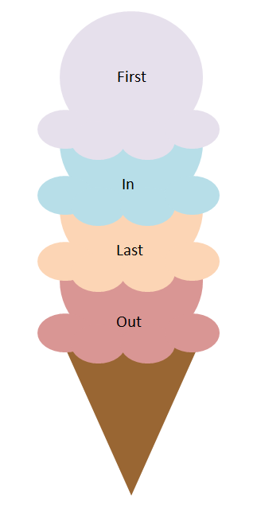
Kurdistan Regional Government-Iraq
Ministry of Higher Education and Scientific Research
Duhok Polytechnic University
Technical Collage of Zakho
Dept. of CIS
Stack Algorithm
Lecturers: Sipan M. Hameed & Ahmed Jamil

Slide 2
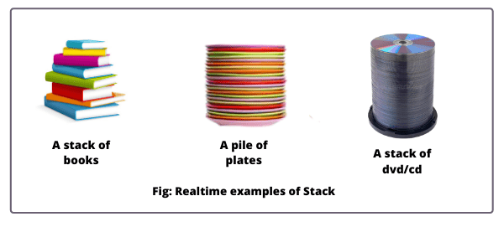
What is a Stack
A stack is a linear data structure that follows the Last In, First Out (LIFO) principle. This means the last element added to the stack is the first one to be removed. Think of it like a stack of plates: you add plates to the top and remove them from the top.

Slide 3
Key Operations on a Stack
A stack supports the following basic operations:
Push: Add an element to the top of the stack.
Pop: Remove the top element from the stack.
Peek (or Top): Represent the current location of data in stack.
isEmpty: Check if the stack is empty.
isFull: Check if the stack is full (only applicable in fixed-size stacks).

Slide 4
Push Operations
The process of putting a new data element onto stack is known as a Push Operation. Push operation involves a series of steps -
Step 1 - Checks if the stack is full.
Step 2 - If the stack is full, produces an error and exit.
Step 3 - If the stack is not full, increments top to point next empty space.
Step 4 - Adds data element to the stack location, where top is pointing.
Step 5 - Returns success.

Slide 5
Pop Operations
Removing an element from the stack, is known as a Pop Operation. In an array implementation of pop() operation, the data element is not actually removed, instead top is decremented to a lower position in the stack to point to the next value. But in linked-list implementation, pop() actually removes data element and deallocates memory space.
A Pop operation may involve the following steps -
Step 1 - Checks if the stack is empty.
Step 2 - If the stack is empty, produces an error and exit.
Step 3 - If the stack is not empty, accesses the data element at which top is pointing.
Step 4 - Decreases the value of top by 1.
Step 5 - Returns success.

Slide 6
Array-based Stack
Add elements in an array S of capacity(size) N.
A variable top keeps track of the index of the top element.
Size is top+1
…
S
0
1
2
t
Notes:
Add elements from left to right (Bottom to top) in an array S of capacity(size) N.
Each of these run in O(1)
Actual application may need less or more memory!

Slide 7
Push and Pop Algorithms
Algorithm push(Element):
if top= N-1 then
throw “Full Stack Exception”
else
top ← top + 1
Algorithm pop():
if isEmpty() then
throw “Empty Stack Exception”
else
top ← top − 1
Run time: O(1)
Run Time: O(1)

Slide 8
Stack Operations - Example
6
Push (7)
{
if top==N-1 Then
“Overflow”
else
Top=Top+1
S[top]=7
}
6
5
5
4
4
3
3
2
2
1
1
Top
0
7
0
Stack S, N=7, Top=-1
Stack S, N=7, Top=0
isEmpty: Check if the stack is empty.

Slide 9
Stack Operations - Example
6
Push (3)
{
if top==N-1 Then
“Overflow”
else
Top=Top+1
S[top]=3
}
6
5
5
4
4
3
3
2
2
3
1
Top
1
Top
7
0
7
0
Stack S, N=7
Stack S, N=7, Top=1

Slide 10
Stack Operations - Example
6
Push (5)
{
if top==N-1 Then
“Overflow”
else
Top=Top+1
S[top]=5
}
6
5
5
4
4
3
3
5
Top
2
2
3
Top
3
1
1
7
0
7
0
Stack S, N=7
Stack S, N=7, Top=2

Slide 11
Stack Operations - Example
6
Push (9)
{
if top==N-1 Then
“Overflow”
else
Top=Top+1
S[top]=9
}
6
5
5
4
4
Top
3
9
3
5
2
Top
5
2
3
1
3
1
7
0
7
0
Stack S, N=7
Stack S, N=7, Top=3

Slide 12
Stack Operations - Example
6
Pop ()
{
if isEmpty() then
“Underflow”
else
Top=Top-1
return
}
6
5
5
4
4
9
Top
3
3
5
2
5
2
Top
3
1
3
1
7
0
7
0
Stack S, N=7
Stack S, N=7, Top=2

Slide 13
Stack Operations - Example
6
6
Pop ()
{
if isEmpty() then
“Underflow”
else
Top--
return
}
5
5
4
4
3
3
5
Top
2
2
3
1
3
Top
1
7
0
7
0
Stack S, N=6
Stack S, N=6, Top=1

Slide 14
Advantages of Stacks
Simplicity: Stacks are a simple and easy-to-understand data structure, making them suitable for a wide range of applications.
Easy Operations : Push and pop operations on a stack can be performed.
Speed of Operations: The primary stack operations - push and pop. Insertion or deletion at the top of the Stack via array indexing is fast .
Limited memory usage: Stacks only need to store the elements that have been pushed onto them, making them memory-efficient compared to other data structures.

Slide 15
Disadvantages of Stacks
Limited access: Elements in a stack can only be accessed from the top, making it difficult to modify elements in the middle of the stack.
Cannot Search Elements: Searching stacks for specific elements is not possible, unlike arrays/linked lists. The element needs to be popped repeatedly until found. Search-heavy use cases are unsuitable for stack-based implementation.
Not suitable for random access: Stacks do not allow for random access to elements, making them unsuitable for applications where elements need to be accessed in a specific order.
Limited capacity: Stacks have a fixed capacity, which can be a limitation if the number of elements that need to be stored.

Slide 16
Applications of Stack Data Structure
Undo/Redo Operations in Text Editors
Back Button in Web Browsers
Infix to Postfix Expression Conversion
Depth First Search in Graphs
Memory Management
Etc…

Slide 17
Thanks

